Slide 1






Hydrological characteristics of degraded soils of a landfill in Northern Italy: a comparison between instrumental data and predictive models
Manfredi P.¹, Cassinari C.², Giupponi L.³, Trevisan M.²
¹ m.c.m. Ecosistemi s.r.l.
² Istituto di Chimica Agraria ed Ambientale, Università Cattolica del Sacro Cuore
³ Istituto di Agronomia, Genetica e Coltivazioni erbacee, Università Cattolica del Sacro Cuore
www.lifeplusecosistemi.eu
LIFE10 ENV/IT/0400NEW LIFE
Total budget 4.025.000 €
EU contribution 1.928.873 €
LE GEOSCIENZE PER LA SOCIETÀ, IX Forum Italiano di Scienze della Terra, Pisa 16-18 settembre 2013

Slide 2
The increase in human activities in recent decades has resulted in an ongoing depletion of soil resources to the point that the relevant authorities have included in their priorities the recovery of degraded areas.
LE GEOSCIENZE PER LA SOCIETÀ, IX Forum Italiano di Scienze della Terra, Pisa 16-18 settembre 2013

Slide 3
A Life+ project: Life 10 ENV/IT/0400 New Life, http://www.lifeplusecosistemi.eu includes, among its objectives, the environmental restoration of a degraded area near Piacenza (Italy).
PROJECT REFERENCE:LIFE10 ENV/IT/000400
DURATION:01-oct-2011 to 30-oct-2016
TOTAL BUDGET:4,025,473.00 €
EU CONTRIBUTION:1,929,837.00 €
PROJECT LOCATION:Emilia-Romagna
LE GEOSCIENZE PER LA SOCIETÀ, IX Forum Italiano di Scienze della Terra, Pisa 16-18 settembre 2013

Slide 4
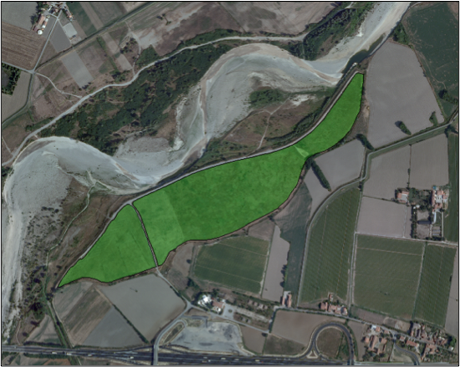
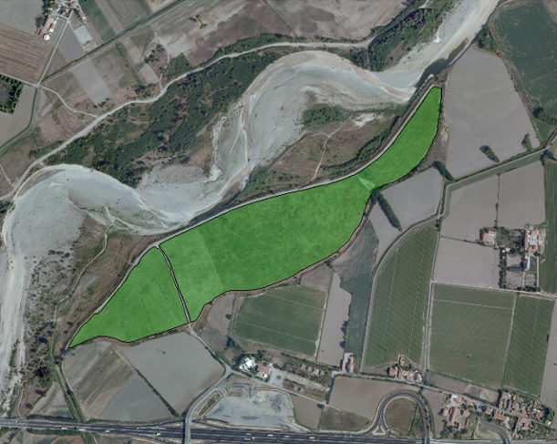
Area of New Life:
Borgotrebbia, Piacenza, Italy.
This area from 1972 to 1985 was a landfill area then covered with a layer of various kinds of soils,on average 50 cm thick, left to be colonized by spontaneous plant species. Since 2005 there are planted some trees and shrubs, which have had little success except in some areas.
Today, the area looks like a grassland characterized by the dominance of ruderal species (Agropyron repens and Hordeum murinum) growing on soils with law structure, poorly drained and with a variable water content depending on the season, subject to intense grazing and only marginally used by the population.
LE GEOSCIENZE PER LA SOCIETÀ, IX Forum Italiano di Scienze della Terra, Pisa 16-18 settembre 2013

Slide 5
Objective of New Life:
experimental development of an innovative technology of chemical–mechanical treatment for recovering degraded soils.
The reconstituted soil has:
Improvement of the structure and increased structural stability
Increase and stabilization of organic matter
Reduction of soil compaction
Increased water retention capacity
Improvement of the heat capacity
Increased cation exchange capacity
Enhancing the buffer
Increase in fertility
Enhancement of biodiversity
Technology:innovative reconstitution method that improves degraded soils through a controlled incorporation of organic matter by means of mechanical and chemical processes that originate neoaggregates of soil.
LE GEOSCIENZE PER LA SOCIETÀ, IX Forum Italiano di Scienze della Terra, Pisa 16-18 settembre 2013

Slide 6
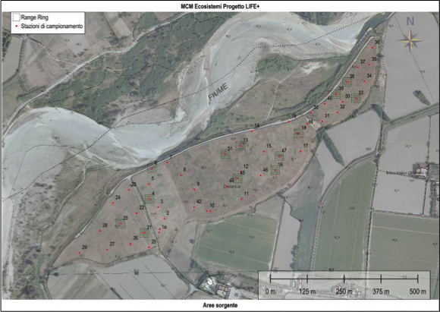
Experimental and work phases of New Life:
Chemical-physical characterization of soil site and identification of homogeneous areas
Investigation and characterization of the matrices to be mixed with the soil
Application of technology by experimental plots using the different soils site together with different types of matrices
Restoration of the degraded area by removing the surface layer of the soil and repositioning of the reconstituted soil, planting of herbs and native tree to recover biodiversity
LE GEOSCIENZE PER LA SOCIETÀ, IX Forum Italiano di Scienze della Terra, Pisa 16-18 settembre 2013

Slide 7
This work is the first phase of New Life consisting in analizyng the landfill soil to describe the different type of soil used to cover the waste.
For this purpose we sampled 11 soils representative of the area and we made chemical, physical and floristic-vegetation analysis of them.
LE GEOSCIENZE PER LA SOCIETÀ, IX Forum Italiano di Scienze della Terra, Pisa 16-18 settembre 2013

Slide 8
Results of the main chemical analysis performed
sample | sand | clay | silt | pH | tot C | O.C. | tot N | C/N | HA+FA | CaCO₃ | salinity | CSC | ISR | depth
 | g/kg | g/kg | g/kg |  | % | % | % |  | g/kg | % | µs/cm | meq/100ml |  | cm
1 | 219 | 123 | 658 | 7,87 | 3,36 | 1,94 | 0,23 | 8,45 | 0,94 | 13,00 | 197 | 16,96 | 76,90 | 55
2 | 179 | 125 | 696 | 7,91 | 5,80 | 4,13 | 0,45 | 9,18 | 0,87 | 14,70 | 212 | 34,27 | 46,00 | 30
3 | 279 | 123 | 598 | 8,10 | 5,62 | 4,14 | 0,35 | 11,82 | 1,18 | 19,00 | 151 | 7,19 | 65,13 | 60
4 | 115 | 147 | 738 | 7,95 | 2,28 | 1,67 | 0,21 | 7,97 | 1,01 | 3,80 | 232 | 20,92 | 102,21 | 30
5 | 122 | 124 | 754 | 8,25 | 2,42 | 1,04 | 0,13 | 7,98 | 1,05 | 13,40 | 167 | 19,08 | 97,42 | 62
6 | 103 | 147 | 750 | 7,78 | 1,78 | 1,35 | 0,18 | 7,48 | 0,90 | 5,70 | 196 | 27,29 | 40,68 | 32
7 | 333 | 125 | 542 | 8,42 | 3,83 | 1,92 | 0,17 | 11,29 | 0,82 | 22,90 | 130 | 22,57 | 128,73 | 45
8 | 167 | 168 | 665 | 7,90 | 6,26 | 4,10 | 0,46 | 8,92 | 0,94 | 26,60 | 288 | 23,67 | 43,78 | 47
9 | 250 | 123 | 627 | 8,06 | 3,78 | 2,35 | 0,26 | 9,05 | 0,93 | 13,80 | 252 | 32,22 | 99,45 | 47
10 | 180 | 98 | 722 | 8,04 | 3,72 | 2,68 | 0,33 | 8,12 | 1,07 | 5,90 | 136 | 31,80 | 71,45 | 50
11 | 178 | 123 | 699 | 7,96 | 4,90 | 3,63 | 0,35 | 10,37 | 1,03 | 12,80 | 248 | 34,10 | 75,68 | 40
mean | 193 | 130 | 677 | 8,02 | 3,98 | 2,63 | 0,28 | 9,15 | 0,98 | 13,78 | 201 | 24,55 | 77,04 | 45
stdev | 72 | 18 | 67 | 0,18 | 1,51 | 1,18 | 0,11 | 1,43 | 0,10 | 7,10 | 51 | 8,43 | 27,91 | 11
LE GEOSCIENZE PER LA SOCIETÀ, IX Forum Italiano di Scienze della Terra, Pisa 16-18 settembre 2013

Slide 9
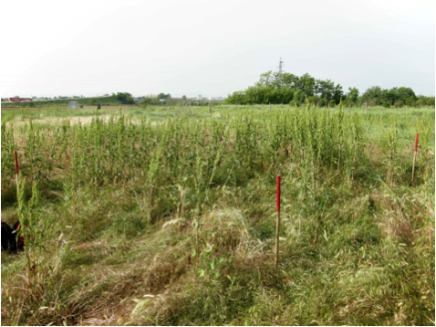
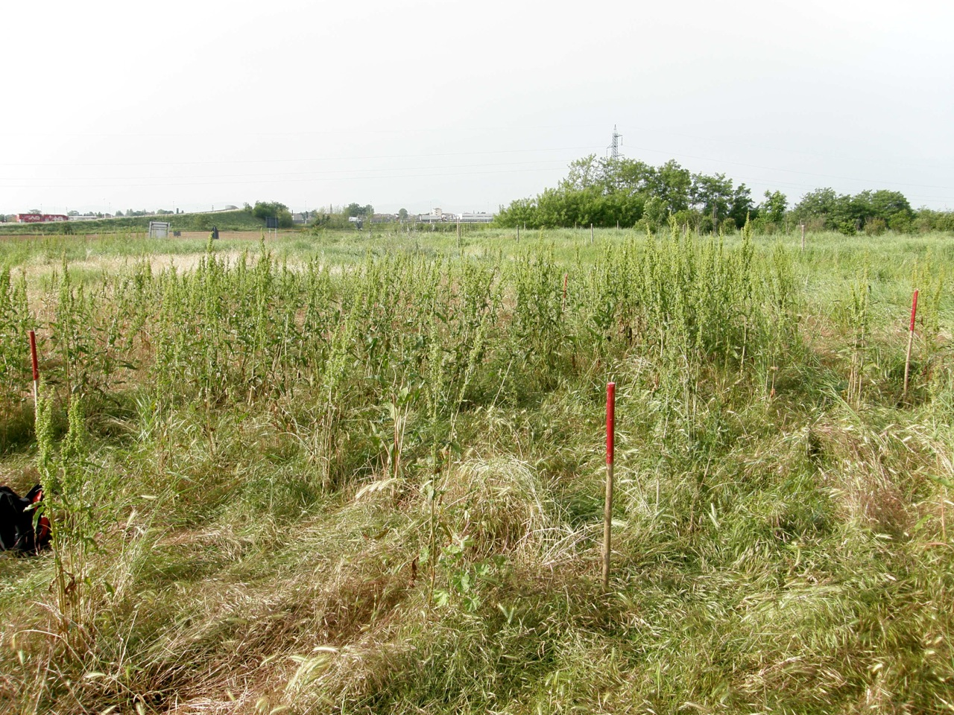
The vegetation of the area is predominantly represented by Therophytes (44%)(ephemeral annual species) that complete their life cycle before the adverse season (dry summer). This vegetation belonge to the phytosociological class Stellarietea mediae which includes nitrophilous annual vegetation of disturbed areas.
LE GEOSCIENZE PER LA SOCIETÀ, IX Forum Italiano di Scienze della Terra, Pisa 16-18 settembre 2013

Slide 10
The results of soils physical-chemical analysis and the vegetation ecological study show the soil degradation.
LE GEOSCIENZE PER LA SOCIETÀ, IX Forum Italiano di Scienze della Terra, Pisa 16-18 settembre 2013

Slide 11
The lower capacity to make water available for the components of the ecosystem is a characteristic of a degraded soil so it is important to study their hydrological behavior.
LE GEOSCIENZE PER LA SOCIETÀ, IX Forum Italiano di Scienze della Terra, Pisa 16-18 settembre 2013

Slide 12
In this work we study the hydrological characteristics of the 11 sample soil and we assess whether predictive systems in use today (PTFs) are suitable for predicting them.
LE GEOSCIENZE PER LA SOCIETÀ, IX Forum Italiano di Scienze della Terra, Pisa 16-18 settembre 2013

Slide 13
Volumetric water content (θ %) from instrumental analysis at different pressure values.
The analysis was performed through tensiometric cassette and Richard’s plates.
sample |  | pressure (-KPa)
 |  | 0,10 | 0,25 | 1,00 | 3,16 | 6,31 | 10,00 | 31,62 | 1496,24
volumetric water content (θ%) | 1 | 38,04 | 33,52 | 30,16 | 28,64 | 27,60 | 26,57 | 21,23 | 18,97
 | 2 | 37,50 | 34,05 | 31,58 | 29,71 | 28,93 | 28,44 | 21,89 | 21,47
 | 3 | 36,75 | 34,70 | 32,18 | 28,46 | 26,77 | 26,02 | 19,78 | 10,44
 | 4 | 38,01 | 35,29 | 31,08 | 27,28 | 25,21 | 23,95 | 17,63 | 17,17
 | 5 | 33,92 | 32,13 | 28,70 | 25,44 | 24,00 | 23,08 | 16,71 | 14,55
 | 6 | 36,51 | 34,66 | 32,00 | 29,29 | 27,71 | 26,81 | 19,45 | 11,22
 | 7 | 34,27 | 31,52 | 29,48 | 25,58 | 23,82 | 22,68 | 14,90 | 8,35
 | 8 | 35,10 | 34,73 | 34,01 | 33,43 | 32,85 | 32,54 | 28,47 | 20,38
 | 9 | 39,24 | 36,70 | 32,89 | 28,75 | 25,83 | 23,50 | 17,90 | 16,03
 | 10 | 41,87 | 40,31 | 36,78 | 31,84 | 29,53 | 27,06 | 20,06 | 10,79
 | 11 | 40,12 | 33,80 | 30,40 | 29,16 | 28,67 | 28,29 | 22,38 | 19,76
Direct measurements of the hydraulic characteristics of soil are rarely performed because they require lengthy and costly analysis; to avoid this, pedotransfer functions (PTFs) are used.
LE GEOSCIENZE PER LA SOCIETÀ, IX Forum Italiano di Scienze della Terra, Pisa 16-18 settembre 2013

Slide 14
PTFs: empirical relationships between the soil hydraulic properties and more easily basic soil properties such as texture, bulk density, organic carbon content.
We used 18 PTFs based on databases of soils distributed worldwide following two models: Brooks and Corey (1964) and van Genuchten (1980); the program SPAW (Soil-Plant-Air-Water) has also been used.
The processing of the PTFs was performed using the program CalcPTF 3.0, the database HYPRES and the SPAW program.
The goodness of the PTFs was calculated through the root mean square error (RMSE) test.
LE GEOSCIENZE PER LA SOCIETÀ, IX Forum Italiano di Scienze della Terra, Pisa 16-18 settembre 2013

Slide 15
The van Genuchten (1980) water retention equation:
The Brooks and Corey (1964) model:
θ = volumetric soil water content (cm³ cm⁻³);
θ_{r}= residual soil water content (cm³ cm⁻³);
θ_{s} = saturated soil water content, (cm³ cm⁻³);
ϕ = soil porosity, (cm³ cm⁻³);
λ = pore size distribution index (dimensionless);
h = capillary pressure (cm);
h_{b} = air-entry pressure (cm);
α = parameter of the van Genuchten equation corresponding approximately to the inverse of the air-entry value, (cm⁻¹);
m, n = empirical shape-defining parameters in the van Genuchten equation, (dimensionless).
LE GEOSCIENZE PER LA SOCIETÀ, IX Forum Italiano di Scienze della Terra, Pisa 16-18 settembre 2013

Slide 16
PTF | region | model
HYPRES | Europe | VG
Saxton et al., 1986 | USA, nationwide | BC
Campbell and Shiosawa, 1992 | No particular | BC
Rawls and Brakensiek, 1985 | USA, nationwide | BC
Williams et al., 1992 | Australia | BC
Williams et al., 1992 | Australia | BC
Oosterveld and Chang, 1980 | Canada, Alberta | BC
Mayr and Jarvice, 1999 | UK | BC
Wösten et al., 1999 | Europe | VG
Varallyay et al., 1982 | Hungary | VG
Vereecken et al., 1989 | Belgium | VG
Wösten et al., 1999 | Europe | VG
Tomasella and Hodnett, 1998 | Brazil | VG
Rawls et al. 1982b* | USA, nationwide | VG
Gupta and Larson, 1979 | Central USA | VG
Rajkai and Varallyay, 1992 | Hungary | VG
Rawls et al. 1983* | USA, nationwide | VG
* = corrected for OM according to Nemes et al., 2009
LE GEOSCIENZE PER LA SOCIETÀ, IX Forum Italiano di Scienze della Terra, Pisa 16-18 settembre 2013

Slide 17
N = number of measurements;
θ_{i} and θ_{i}* = real and estimated volumetric water content (θ%).
PTF | RMSE (%)
 | 1 | 2 | 3 | 4 | 5 | 6 | 7 | 8 | 9 | 10 | 11
HYPRES | 12,8 | 12,3 | 13 | 14,2 | 15,9 | 13 | 15,2 | 7 | 12,6 | 9,7 | 12,2
Saxton et al., 1986 | 12,6 | 12,3 | 11,6 | 14,1 | 15,7 | 12,6 | 13,8 | 17,1 | 12,2 | 10,2 | 12,3
Campbell and Shiosawa, 1992 | 13,1 | 12,6 | 13,1 | 15,6 | 17 | 14,8 | 15,6 | 10,3 | 13,4 | 11,3 | 12,6
Rawls and Brakensiek, 1985 | 11,5 | 11,3 | 10,5 | 13,5 | 14,9 | 12,2 | 12,7 | 17,8 | 10,9 | 8,4 | 11,3
Williams et al., 1992 | 9,7 | 9,1 | 9,7 | 11,1 | 12,6 | 10,3 | 12,5 | 6,1 | 9,6 | 6,4 | 9,1
Williams et al., 1992 | 11 | 11,7 | 11,4 | 12,5 | 14,1 | 11,3 | 11,8 | 11,3 | 10,6 | 8,5 | 11,4
Oosterveld and Chang, 1980 | 11,6 | 10,9 | 10,9 | 13,6 | 15,2 | 12,5 | 12,9 | 12,9 | 11 | 8,3 | 10,9
Mayr and Jarvice, 1999 | 12,2 | 13,3 | 10,5 | 10,4 | 9,8 | 11 | 9,1 | 22,3 | 10,5 | 11,3 | 12,8
Wösten et al., 1999 | 8,9 | 5,4 | 9 | 10,4 | 13,1 | 10,2 | 12,1 | 7,1 | 9 | 6,3 | 8,2
Varallyay et al., 1982 | 5,2 | 5,7 | 3 | 5,6 | 6,1 | 3,8 | 5,7 | 10,5 | 4,1 | 2,5 | 5,3
Vereecken et al., 1989 | 8,5 | 8,6 | 8,4 | 12 | 11,6 | 10,7 | 10,7 | 5 | 8,5 | 3,3 | 8,1
Wösten et al., 1999 | 8,5 | 8,3 | 8,8 | 9,9 | 11,3 | 8,5 | 10,5 | 5,2 | 8,5 | 6,2 | 8,2
Tomasella and Hodnett, 1998 | 24,8 | 26,9 | 23,4 | 29,6 | 31,5 | 29,1 | 22,7 | 15,9 | 23,5 | 24,3 | 26,6
Rawls et al. 1982b* | 13,2 | 16,1 | 15,8 | 15,4 | 15,8 | 13,7 | 14,8 | 10 | 13,6 | 11,8 | 15,2
Gupta and Larson, 1979 | 16,2 | 17,6 | 16,6 | 19,6 | 20,8 | 18,7 | 17,2 | 10,1 | 16,1 | 15,2 | 17,3
Rajkai and Varallyay, 1992 | 18,9 | 15,9 | 17,1 | 19,3 | 21,8 | 18,5 | 20 | 11,3 | 18,5 | 18,9 | 16,7
Rawls et al. 1983* | 11,3 | 12,5 | 12,7 | 13,2 | 14 | 11,7 | 13,1 | 7 | 11,5 | 9,2 | 12,1
* = corrected for OM according to Nemes et al., 2009
LE GEOSCIENZE PER LA SOCIETÀ, IX Forum Italiano di Scienze della Terra, Pisa 16-18 settembre 2013

Slide 18
real and theorical water retention curves
Real (red) and theoretical water retention curves; the curve with best RMSE (6,1 %) is highlighted, and the worst (31,5 %) is dashed.
LE GEOSCIENZE PER LA SOCIETÀ, IX Forum Italiano di Scienze della Terra, Pisa 16-18 settembre 2013

Slide 19
All the hydraulic data of the landfill cover soils (instrumentally and PTFs) were compared with those of an hypothetical soil with the following chemical-physical characteristics.
sample | texture | b.d.* | p.d.* | O.C. | depth | structure
 |  | g/cm³ | g/cm³ | % | cm
hypothetical soil | silty loam | 1,4 | 2,6 | 1,0 | 100 | good
mean of landfill soils | silty loam | 1,4 | 2,6 | 2,6 | 45 | compacted
* b.d. = bulk density; p.d. = particle density
LE GEOSCIENZE PER LA SOCIETÀ, IX Forum Italiano di Scienze della Terra, Pisa 16-18 settembre 2013

Slide 20
real (red) and hypothetical* (gray) water retention curves
* = The volumetric water content at different pressures was calculated through the average of the water contents resulting from the 18 PTFs.
LE GEOSCIENZE PER LA SOCIETÀ, IX Forum Italiano di Scienze della Terra, Pisa 16-18 settembre 2013

Slide 21
Comparison of the water content at different pressure values between all the soils sampled and the hypothetical control soil
LE GEOSCIENZE PER LA SOCIETÀ, IX Forum Italiano di Scienze della Terra, Pisa 16-18 settembre 2013

Slide 22
Volumetric water content at -0,10 KPa
Water holding capacity | θ%
hypothetical control soil | 76,59
mean of site soils | 37,39 ± 2,45
LE GEOSCIENZE PER LA SOCIETÀ, IX Forum Italiano di Scienze della Terra, Pisa 16-18 settembre 2013

Slide 23
Volumetric water content at mean between -10 KPa and -31,62 KPa
Field capacity | θ%
hypothetical control soil | 37,74
mean of site soils | 23,15 ± 3,24
LE GEOSCIENZE PER LA SOCIETÀ, IX Forum Italiano di Scienze della Terra, Pisa 16-18 settembre 2013

Slide 24
Volumetric water content at -1496,24 KPa
Wilting point | θ%
hypothetical control soil | 14,95
mean of site soils | 15,38 ± 4,59
LE GEOSCIENZE PER LA SOCIETÀ, IX Forum Italiano di Scienze della Terra, Pisa 16-18 settembre 2013

Slide 25
Available water
Available water | θ%
hypothetical control soil | 22,79
mean of site soils | 7,78 ± 3,73
LE GEOSCIENZE PER LA SOCIETÀ, IX Forum Italiano di Scienze della Terra, Pisa 16-18 settembre 2013

Slide 26
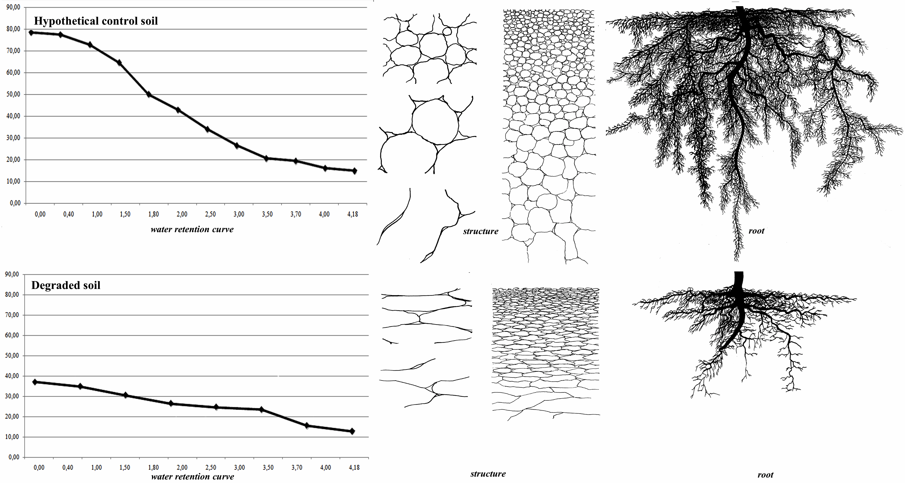
LE GEOSCIENZE PER LA SOCIETÀ, IX Forum Italiano di Scienze della Terra, Pisa 16-18 settembre 2013

Slide 27
From the study of the hydraulic characteristics of landfill cover soils it has emerged that these have less available water compared to a hypothetical soil with less organic carbon content; this represents an aspect of degradation.
The low water content, together with the lack of depth and compacted structure, would justify the presence of a vegetation consisting predominantly of therophytes instead of a more developed and stable perennial vegetation with shrubs and trees, as observed for other landfills several years after their coverage.
LE GEOSCIENZE PER LA SOCIETÀ, IX Forum Italiano di Scienze della Terra, Pisa 16-18 settembre 2013

Slide 28

Thanks for your attention
LE GEOSCIENZE PER LA SOCIETÀ, IX Forum Italiano di Scienze della Terra, Pisa 16-18 settembre 2013

